Slide 1
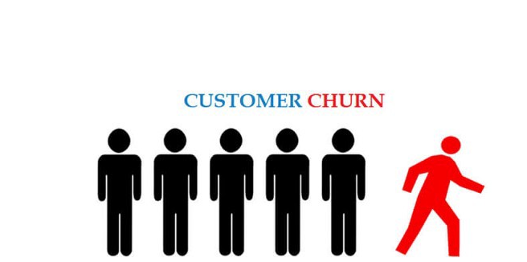
Telecom Customer Churn Prediction
Submitted by: Shekhar Pratap Singh
Mentored by:
Mr. Sravan Malla

Slide 2

Problem Definition:
Objective
Situation
Predict the customer churn for the telecom industry.
Customer churn is focal concern of most companies which are active in low switching cost. Telecom industry can be considered in the top of the list.
Scope
Enables telecom companies to reduce risk of churn loss.
Complication
Churn is a problem for telecom companies because it is more expensive to acquire a new customer than to keep your existing one from leaving.
Additional Benefit
Recognizing the churners before they churn and make the right retaining strategies to retain them.

Slide 3

Dataset Description:
It is a classification problem.
Data set consists of 21 columns including target variable with 7043 rows.
18 categorical and 3 numerical columns are present.
Churn is the target variable which notifies whether a particular customer is churn or not.
Challenges faced:
Incorrect Data Types
01
01
Conversion
02
02
Null Values
Imputing methods
03
03
Data Imbalanced
Upsampling

Slide 4

All about data
Customers who unsubscribed: Churn
Demographics of customer: Customer-id, Gender, Age range, whether they have partners or dependents
Account information:
how long they’ve been a customer, contract, payment method, paperless billing, monthly charges, and total charges
Services opted by customer: phone, multiple lines, internet, online security, online backup, device protection, tech support, and streaming TV and movies

Slide 5
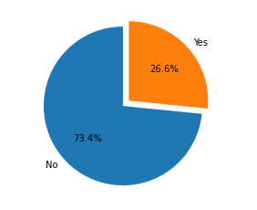
Visualize target feature
Churn
Interpretation:
Target variable is not balanced
Risks:
Lead to biased results
Accuracy paradox
Resolution:
Re-sampling the data

Slide 6
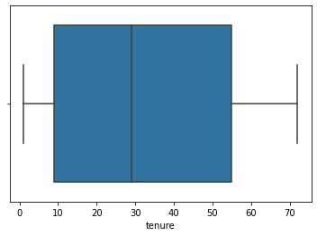
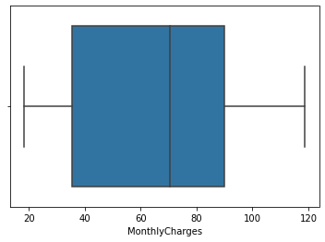
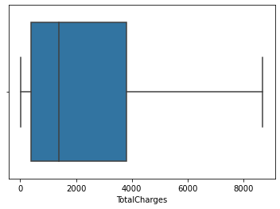
Outliers Detection
Interpretation:
No outliers are present in data
Further Action:
No action needs to be performed

Slide 7
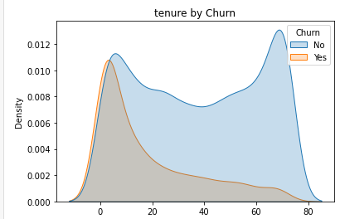
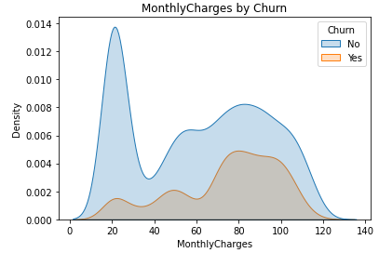
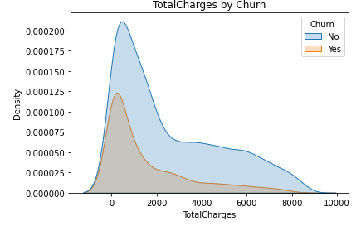
Numerical vs Target Variable
Interpretation:
High rate of churn is seen when Total charges are between 500-1000
Rate of churn is increasing with increase in Monthly charges
More customers are getting churned at initial stages of subscription

Slide 8
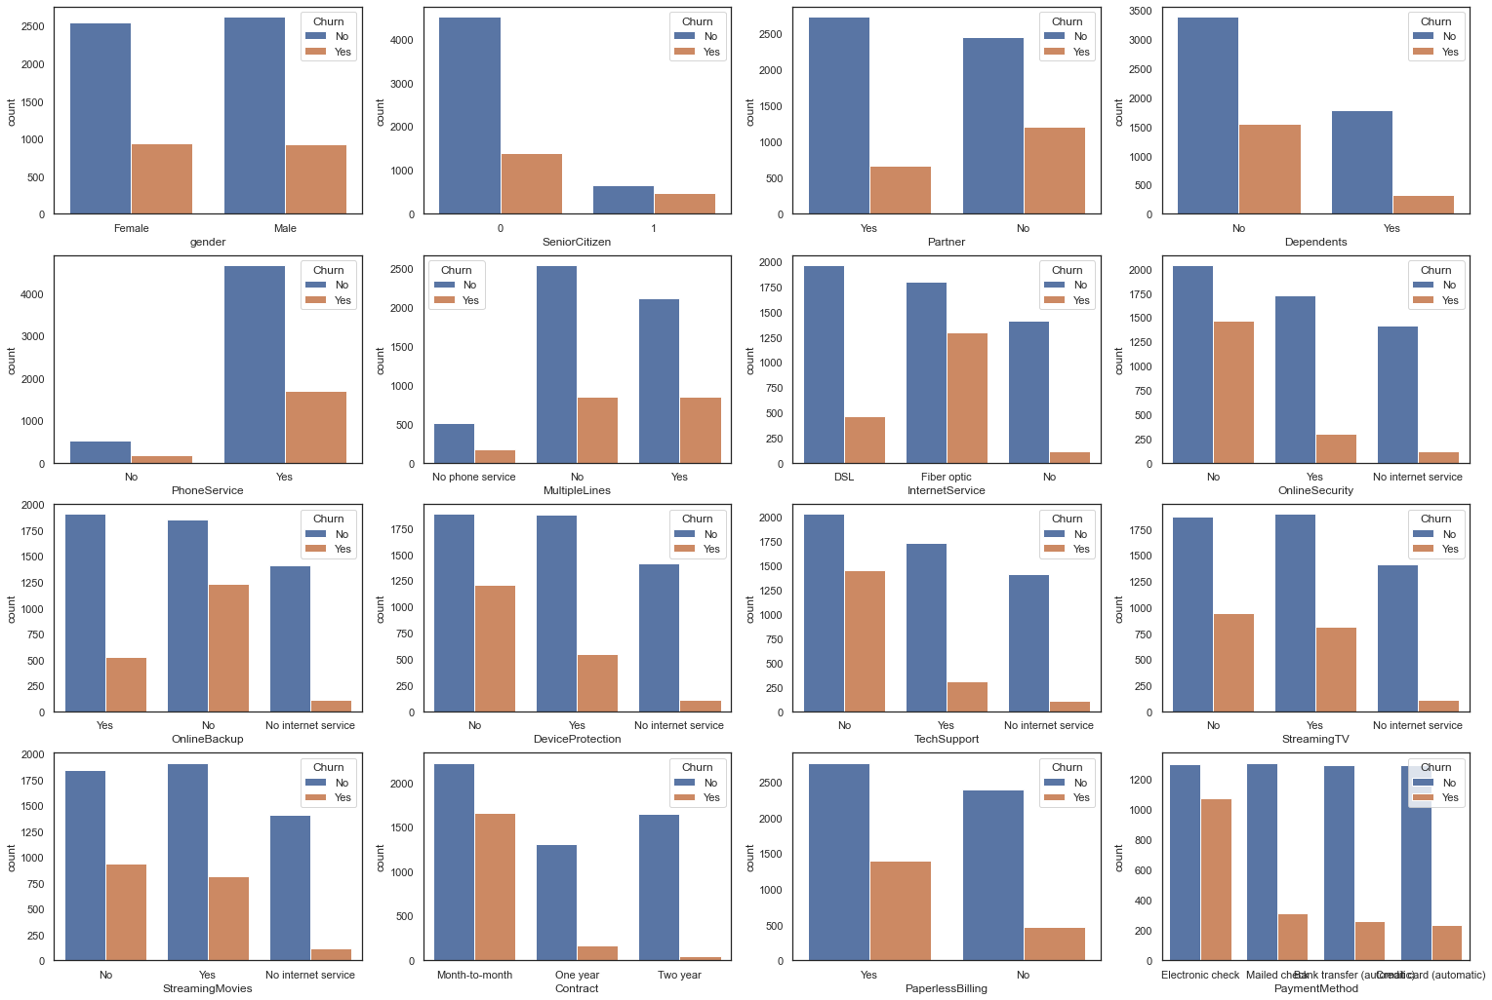
Target vs Categorical features
Notes:
Interpretations:
Gender: Churn is not affected by gender.
Senior Citizen: rate of churn is higher in Senior citizens when compared to non senior citizens
Partner: Customers with No partners are more likely to churn
Dependents: Customers with No dependent are more likely to churn
Phone Services: Most of the Customers are having phone services but the rate of churn is not dependent on it.
Multiple lines: Multiple lines is also not affecting the churn of customers
Internet Services: High churn rate is seen in subscribed customers who are using Fiber optics
Online Security, online backup, Device protection, Tech Support: Customers who are least interested in opting these services are more likely to churn.
Streaming Movies is not affecting the churn rate
Customers who opted for month-month contract are more likely to churn
Customers who are using Electronic billing are more likely to churn

Slide 9
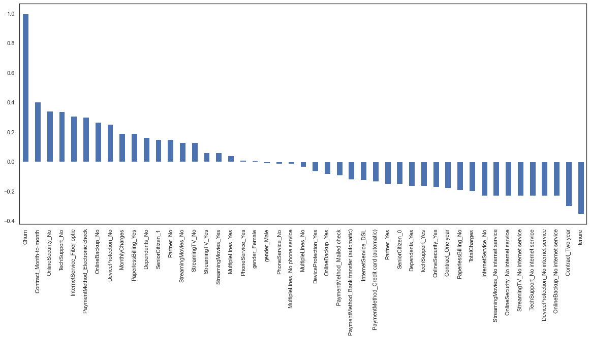
Impact of Features on Churn

Slide 10
Base Model Performance
Logistic Regression
Metrics | Training Score | Testing Score
Accuracy | 81.00 | 81.00
Precision | 65.00 | 74.00
Recall | 54.00 | 54.00
F1_score | 59.00 | 62.00
Roc_Auc | 84.47 | 86.04
After performing logistic regression on the training and test data although model is neither overfitted nor underfitted
We have observed that count of FN is high which is close to TP and should be reduced.
Aim is to improve Recall by decreasing False Negatives

Slide 11
Performance Metrics different models
Building different base models using different Algorithms
We can observe that Decision Tree & Random Forest are overfitted.

Slide 12
Performance Improvement Techniques
Upsampling (SMOTE)
Best Features selection (k - Best)
Youden’s Index calculation
Hyper Parameter Tuning (grid search cv)

Slide 13
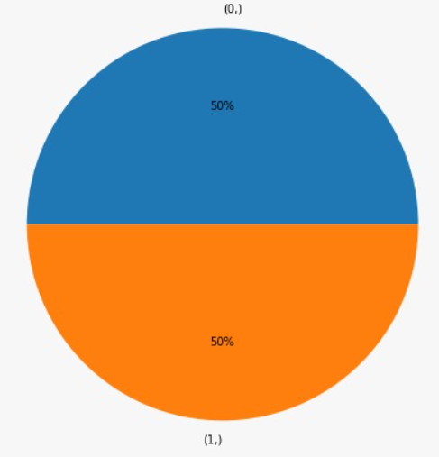
Up – sampling
Used up sampling of Minority class to balance the data using SMOTE function on train data

Slide 14
Best Features
13 features are obtained using select k best features
Tenure
Monthly Charges
Total Charges
Partner_Yes
Dependents_Yes
Internet Service_Fiber optic
Internet Service_No
Online Security_Yes
TechSupport_Yes
Contract_One Year
Contract_Two Year
Paperless Billing_Yes
Payment Method_Electronic check

Slide 15
Youden’s Index calculation
Comparing Logistic model built on up sampled data using best features with different threshold values

Slide 16
Comparing models after applying ensemble techniques
After applying ensemble techniques, model is neither overfit nor underfit

Slide 17
Stacking
Base Model : Random Forest tuned , Gaussian Naive Bayes , Ada Boost tuned, Logistic Regression
Final Estimator : Logistic Regression
Metrics | Training Score | Testing Score
Accuracy | 79.00 | 77.00
Precision | 78.00 | 58.00
Recall | 82.00 | 74.00
F1_score | 80.00 | 65.00
Roc_Auc | 90.00 | 85.49

Slide 18
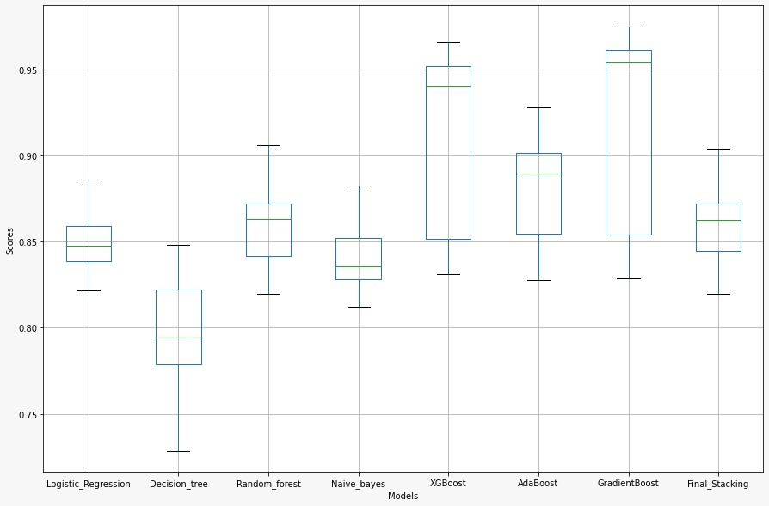
Model comparison – AUC

Slide 19
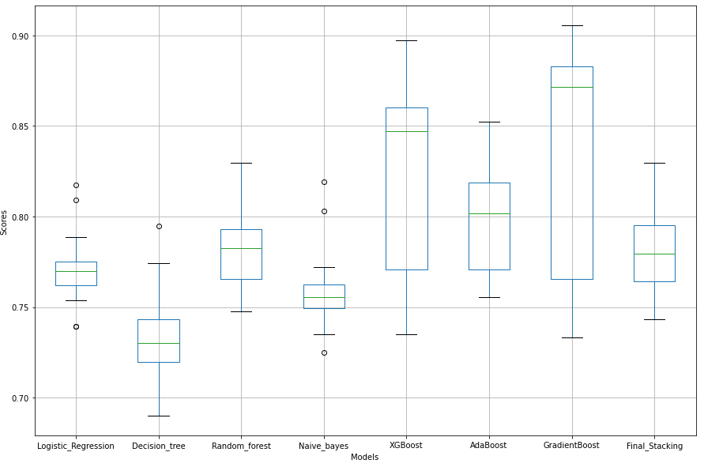
Model comparison – Accuracy
We are finalizing Logistic Regression model because it has minimum variance on test results.
XGBoost and GradientBoost have high accuracy, but they are vulnerable to variance

Slide 20
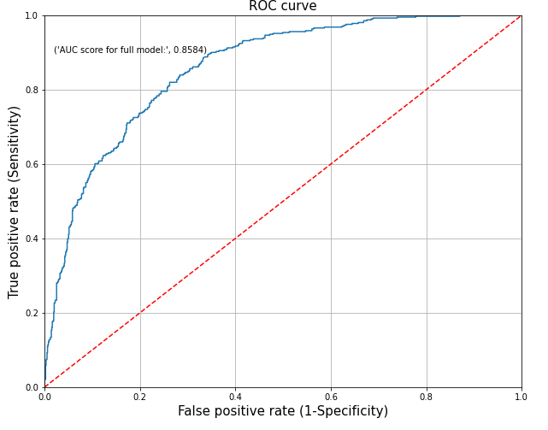
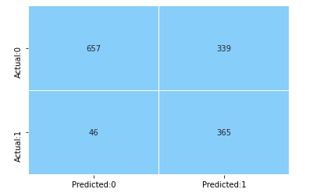
Performance Metrics for Final Model
Accuracy – 73
Recall – 89
Precision – 52
F1 score – 65
AUC - 86

Slide 21
Odds for each feature

Slide 22
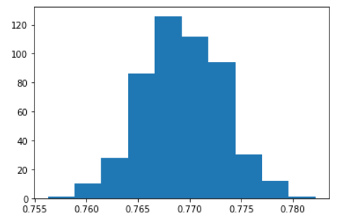
Range Estimate for final Model
Distribution Accuracy for 500 bootstrap sample
95% confidence interval range of accuracy score for Logistic Regression model is 76.2% to 77.7%

Slide 23
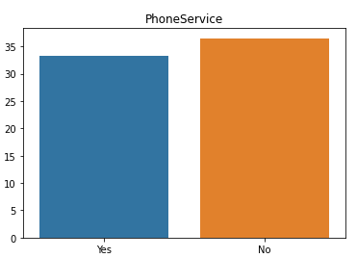
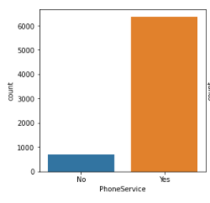
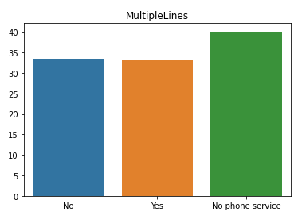
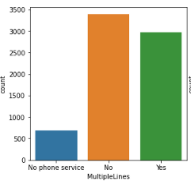
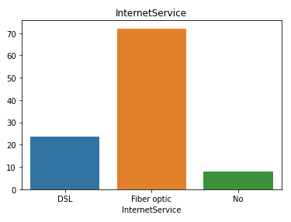
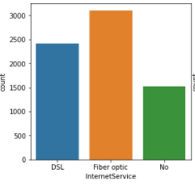
Business insights for Services Opted
Churn Rate
Distribution
Churn rate in different classes of Phone Services and Multiple Lines are almost same. No conclusion can be derived. But there is more churn seen in customers who opted Fiber optics as Internet services. This shows clear dissatisfaction services provided by fiber Optics

Slide 24
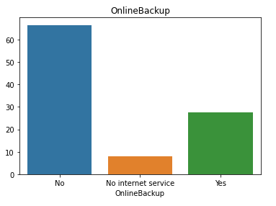
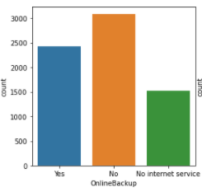
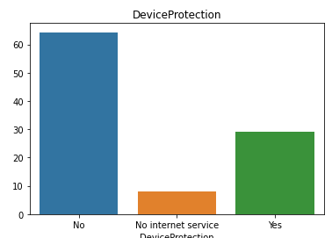
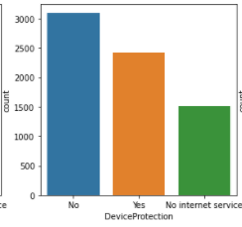
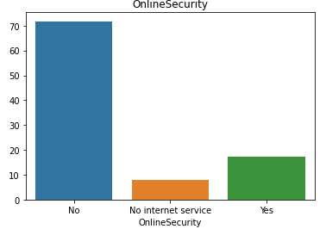
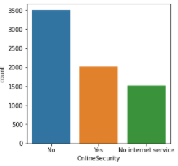
Business insights for Services Opted
Churn Rate
Distribution
Customers opted No for online security, online backup, Device protection is more.
And the churn rate among the costumers with ‘Yes’ is Less.
This may be due to customers may find worth of services provided by Telecom company.
Company should focus on customers to opt for the services

Slide 25
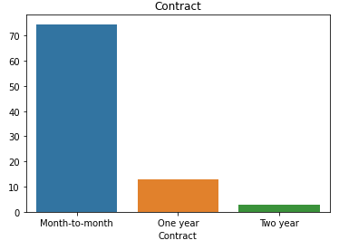
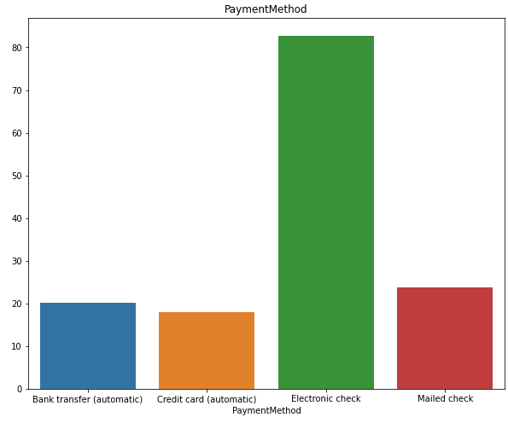
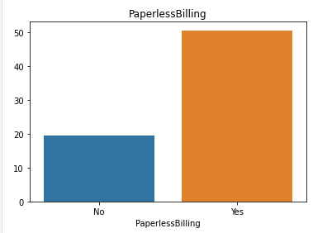
Business Insights
The difference between a Month-to-month and annual contracts is bigger and can lead to a conclusion that annual contracts are better to retain the clients, perhaps fidelity promotions could aid to reduce the churn rate.
Customers opted for paperless billing are more likely to churn and Customers who opted for Electronic Check as payment method are more likely to churn. May be paperless billing experience needs to be improved. A good idea could make promotions to clients that use automatic payment methods.

Slide 26
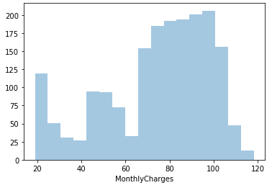
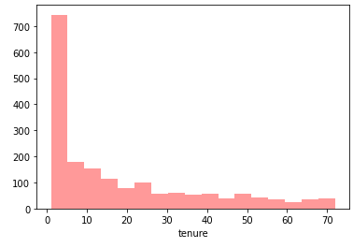
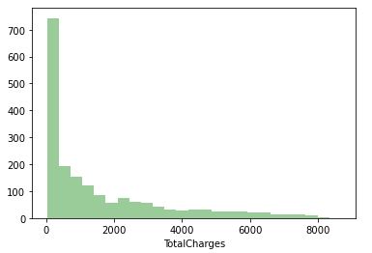
Business Insights
Monthly Charges for many churned clients was high, maybe the amount of change value could lead the client to leave the service.
Most clients just opted for one month, seems like the clients used to service to check the quality or they couldn't stay as the Monthly Charges for these clients was high
Total Charges for churned customers was small, as the client just stayed a little time

Slide 27
Assumptions
Since target feature is not balanced, assuming the data generated using up-sampling have resemblance with original data
Limitations
Computational power for calculating Range estimates.
Sample data set considered is representation of Population
There was no Bias is data collection
Since no information about the locality of customer is provided, we are assuming that churn rate is not affected by the demographics like location
Size of Data set
Imbalance of target variable

Slide 28
Conclusion
The type of contract has a strict relationship with churned clients, Month-to-month contracts with high amount of charges could lead a client to leave the service.
95% confidence interval range of accuracy score for model is 76.2% to 77.7%.
Increased recall from 54% to 89%.
Resampling of data using SMOTE increase model performance

Slide 29


